Slide 1

University Institute of Engineering
DEPARTMENT OF COMPUTER SCIENCE & ENGINEERING
Bachelor of Engineering (Computer Science & Engineering)
Subject Name : Machine Learning
Subject Code: CST-316
Topic: K means Clustering (CO2, CO3)
Lecture-3.1
DISCOVER . LEARN . EMPOWER

Slide 2
Course Outcomes
CO-1:Apply the basic concept of Machine learning and statistics learning to deal with real-life Problems.
CO-2: Understand different machine learning algorithms, as well as underlying theories the behind them.
CO-3: Select and apply the appropriate machine learning algorithm to solve problems of moderate complexity
CO-4: Interpret and evaluate models generated from data.
CO-5: Optimize the models learned and report on the expected accuracy that can be attained by applying the algorithms to a real-world problem.

Slide 3
Course Objectives
To understand the history and development of Machine Learning.
To provide a comprehensive foundation to Machine Learning and Optimization methodology with applications t.
To study learning processes: supervised and unsupervised, deterministic and statistical knowledge of Machine learners, and ensemble learning
To understand modern techniques and practical trends of Machine learning.

Slide 4
Partitional Clustering
Given
A data set of n objects
K the number of clusters to form
Organize the objects into k partitions (k<=n) where each partition represents a cluster
The clusters are formed to optimize an objective partitioning criterion
Objects within a cluster are similar
Objects of different clusters are dissimilar

Slide 5
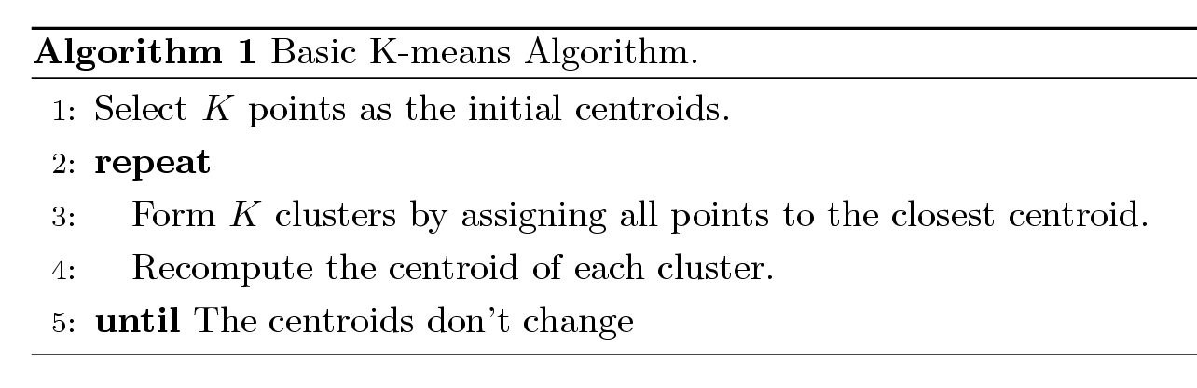
K-means Clustering
The basic algorithm is very simple
Number of clusters, K, must be specified
Each cluster is associated with a centroid (mean or center point)
Each point is assigned to the cluster with the closest centroid

Slide 6
K-means clustering
Works with numeric data only
Pick a number (K) of cluster centers (at random)
Assign every item to its nearest cluster center (e.g. using Euclidean distance)
Move each cluster center to the mean of its assigned items
Repeat steps 2,3 until convergence (change in cluster assignments less than a threshold)

Slide 7
K-means Clustering – Details
Initial centroids are often chosen randomly.
Clusters produced vary from one run to another.
The centroid is (typically) the mean of the points in the cluster.
‘Closeness’ is measured by Euclidean distance, cosine similarity, correlation, etc.
K-means will converge for common similarity measures mentioned above.
Most of the convergence happens in the first few iterations.
Often the stopping condition is changed to ‘Until relatively few points change clusters’ or some measure of clustering doesn’t change.
Complexity is O( n * K * I * d )
n = number of points, K = number of clusters, I = number of iterations, d = number of attributes

Slide 8
Evaluating K-means Clusters
Most common measure is Sum of Squared Error (SSE)
For each point, the error is the distance to the nearest cluster
To get SSE, we square these errors and sum them.
x is a data point in cluster C_{i} and m_{i} is the representative point for cluster C_{i}
can show that m_{i} corresponds to the center (mean) of the cluster
Given two clusters, we can choose the one with the smallest error
One easy way to reduce SSE is to increase K, i.e. the number of clusters
A good clustering with smaller K can have a lower SSE than a poor clustering with higher K

Slide 9
Two different K-means Clusterings
Original Points
Optimal Clustering
Sub-optimal Clustering

Slide 10
Importance of Choosing Initial Centroids (Case i)

Slide 11
Importance of Choosing Initial Centroids (Case i)

Slide 12
Importance of Choosing Initial Centroids (Case ii)

Slide 13
Importance of Choosing Initial Centroids (Case ii)

Slide 14
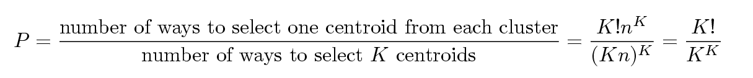
Problems with Selecting Initial Points
If there are K ‘real’ clusters then the chance of selecting one centroid from each cluster is small.
Chance is relatively small when K is large
If clusters are the same size, n, then
For example, if K = 10, then probability = 10!/10¹⁰ = 0.00036
Sometimes the initial centroids will readjust themselves in ‘right’ way, and sometimes they don’t
Consider an example of five pairs of clusters
Initial centers from different clusters may produce good clusters

Slide 15
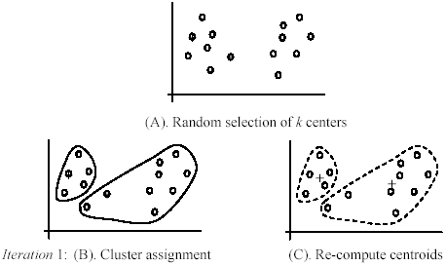
Another example
+
+

Slide 16
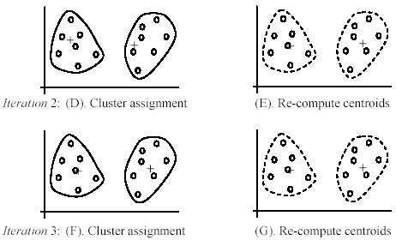
(cont …)

Slide 17
K-means example, step 1
k₁
Y
Pick 3
initial
cluster
centers
(randomly)
k₂
k₃
X

Slide 18
K-means example, step 2
k₁
Y
k₂
Assign
each point
to the closest
cluster
center
k₃
X

Slide 19
K-means example, step 3
k₁
k₁
Y
Move
each cluster center
to the mean
of each cluster
k₂
k₃
k₂
k₃
X

Slide 20
K-means example, step 4
Reassign
points
closest to a different new cluster center
Q: Which points are reassigned?
k₁
Y
k₃
k₂
X

Slide 21
K-means example, step 4 …
k₁
Y
A: three points with animation
k₃
k₂
X

Slide 22
K-means example, step 4b
k₁
Y
re-compute cluster means
k₃
k₂
X

Slide 23
K-means example, step 5
k₁
Y
k₂
move cluster centers to cluster means
k₃
X

Slide 24
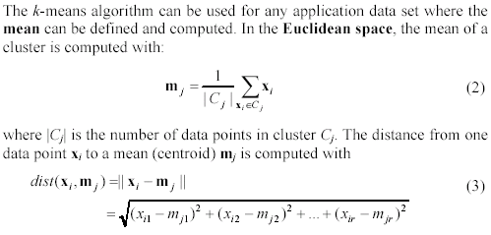
An example distance function

Slide 25
Strengths of k-means
Strengths:
Simple: easy to understand and to implement
Efficient: Time complexity: O(tkn),
where n is the number of data points,
k is the number of clusters, and
t is the number of iterations.
Since both k and t are small. k-means is considered a linear algorithm.
K-means is the most popular clustering algorithm.
Note that: it terminates at a local optimum if SSE is used. The global optimum is hard to find due to complexity.

Slide 26
Weaknesses of k-means
The algorithm is only applicable if the mean is defined.
For categorical data, k-mode - the centroid is represented by most frequent values.
The user needs to specify k.
The algorithm is sensitive to outliers
Outliers are data points that are very far away from other data points.
Outliers could be errors in the data recording or some special data points with very different values.

Slide 27
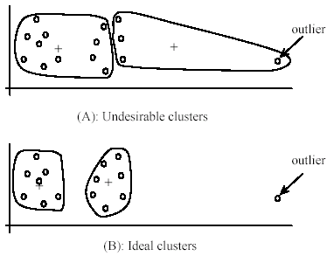
Weaknesses of k-means: Problems with outliers

Slide 28
Weaknesses of k-means: To deal with outliers
One method is to remove some data points in the clustering process that are much further away from the centroids than other data points.
To be safe, we may want to monitor these possible outliers over a few iterations and then decide to remove them.
Another method is to perform random sampling. Since in sampling we only choose a small subset of the data points, the chance of selecting an outlier is very small.
Assign the rest of the data points to the clusters by distance or similarity comparison, or classification

Slide 29
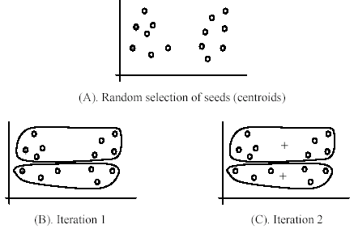
Weaknesses of k-means (cont …)
The algorithm is sensitive to initial seeds.

Slide 30
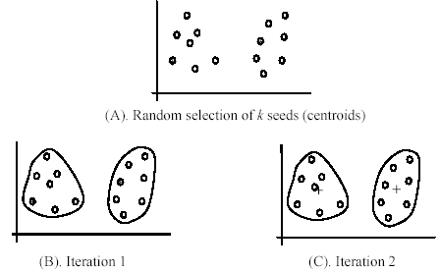
Weaknesses of k-means (cont …)
If we use different seeds: good results
There are some methods to help choose good seeds

Slide 31
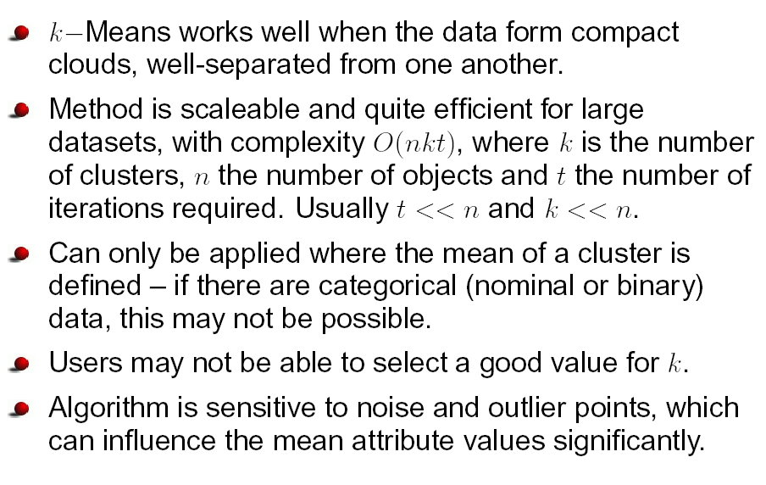
Pros and cons of K-Means

Slide 32
K-means clustering summary
Advantages
Simple, understandable
items automatically assigned to clusters
Disadvantages
Must pick number of clusters before hand
All items forced into a cluster
Too sensitive to outliers since an object with an extremely large value may substantially distort the distribution of data

Slide 33
K-means summary
Despite weaknesses, k-means is still the most popular algorithm due to its simplicity, efficiency and
other clustering algorithms have their own lists of weaknesses.
No clear evidence that any other clustering algorithm performs better in general
although they may be more suitable for some specific types of data or applications.
Comparing different clustering algorithms is a difficult task. No one knows the correct clusters!

Slide 34
K-means variations
K-medoids – instead of mean, use medians of each cluster
Mean of 1, 3, 5, 7, 9 is
Mean of 1, 3, 5, 7, 1009 is
Median of 1, 3, 5, 7, 1009 is
Median advantage: not affected by extreme values
For large databases, use sampling
5
205
5

Slide 35
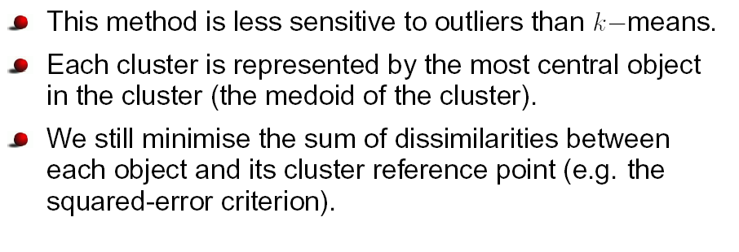
k-Medoids

Slide 36
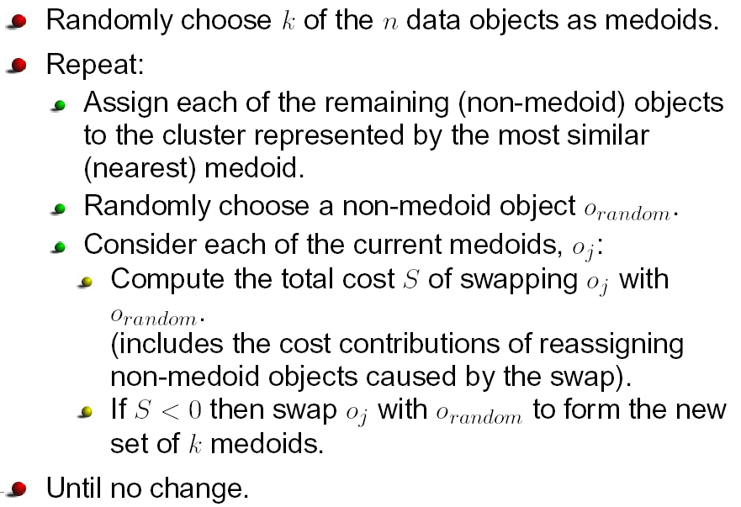
The k-Medoids Algorithm

Slide 37
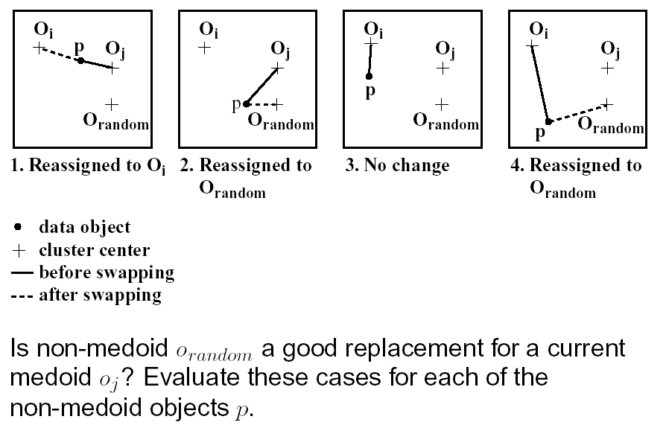
Evaluating Cost of Swapping Medoids

Slide 38
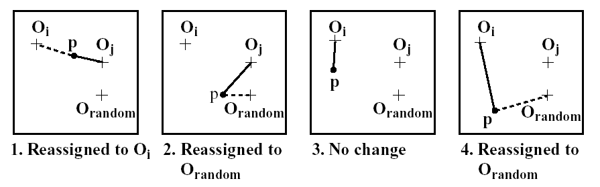
Evaluating Cost of Swapping Medoids

Slide 39
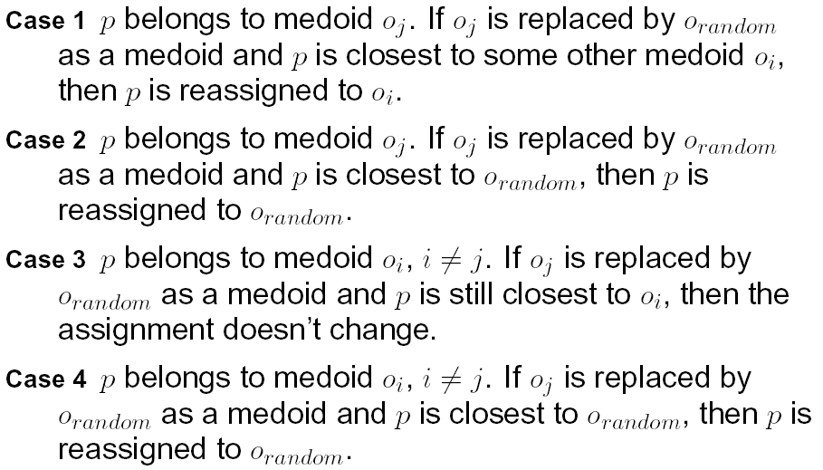
Four Cases

Slide 40
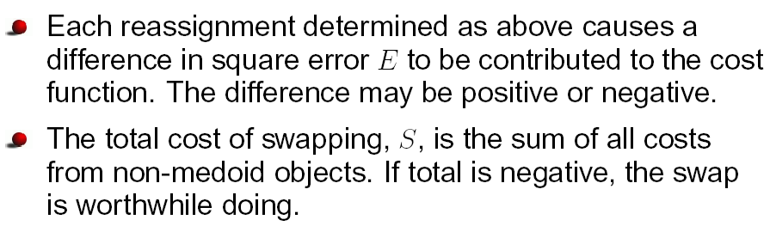
Total Cost of Swap

Slide 41
Summary
K-means – simple, sometimes useful
K-medoids is less sensitive to outliers
K-means clustering is the unsupervised machine learning algorithm that is part of a much deep pool of data techniques and operations in the realm of Data Science.
It is the fastest and most efficient algorithm to categorize data points into groups even when very little information is available about data.

Slide 42
References
Books and Journals
Understanding Machine Learning: From Theory to Algorithms by Shai Shalev-Shwartz and Shai Ben-David-Cambridge University Press 2014
Introduction to machine Learning – the Wikipedia Guide by Osman Omer.
Video Link-
https://www.youtube.com/watch?v=SeswFFdH03U
https://www.youtube.com/watch?v=iNlZ3IU5Ffw
Web Link-
https://en.wikipedia.org/wiki/K-means_clustering
https://link.springer.com/10.1007/978-0-387-30164-8_425
https://towardsdatascience.com/a-practical-guide-on-k-means-clustering-ca3bef3c853d

Slide 43
THANK YOU

